Slide 1
Introduction to Triggers
Notes:
Schedule: Topic Timing
Lecture 15 minutes
Total 15 minutes

Slide 2
Objectives
After completing this lesson, you should be able to do the following:
  Define triggers
  Identify the different trigger categories
  Plan the type and scope of triggers in a form
  Describe the properties that affect the behavior of a trigger
Notes:
Objectives
Triggers are one of the most important mechanisms that you can use to modify or add to the functionality of a form. In this lesson, you learn the essential rules and properties of triggers so that you can use them throughout your application.

Slide 3
Trigger Overview
PL/SQL
Queries
Validation
Navigation
Interaction
Internal event
Errors/Messages
Others
Event
Fire
PL/SQL
PL/SQL
Trigger types
Notes:
Trigger Overview
A trigger is a program unit that is executed (fired) due to an event. As explained earlier, Forms Builder enables you to build powerful facilities into applications without writing a single line of code. You can use triggers to add or modify form functionality in a procedural way. As a result, you can define the detailed processes of your application.
You write Forms Builder triggers in PL/SQL. Every trigger that you define is associated with a specific event. Forms Builder defines a vast range of events for which you can fire a trigger. These events include the following:
Query-related events
Data entry and validation
Logical or physical navigation
Operator interaction with items in the form
Internal events in the form
Errors and messages
Events cause the activation, or firing, of certain trigger types.

Slide 4
Trigger Categories
Triggers may be grouped into functional categories:
  Block processing triggers
  Interface event triggers
  Master-detail triggers
  Message handling triggers
  Navigational triggers
  Query-time triggers
  Transactional triggers
  Validation triggers
Triggers may be grouped into categories based on name:
  When-Event triggers
  On-Event triggers
  Pre-Event triggers
  Post-Event triggers
  Key triggers
Notes:
Trigger Categories
Triggers may be categorized based on their functions:
You can also categorize triggers based on their names:

Slide 5

Trigger Components
Type
What event?
Code
What action?
Scope
What level?
Notes:
Trigger Components
There are three main components to consider when you design a trigger in Forms Builder:
Trigger type: Defines the specific event that will cause the trigger to fire
Trigger code: The body of PL/SQL that defines the actions of the trigger
Trigger scope: The level in a form module at which the trigger is defined—determining the scope of events that will be detected by the trigger

Slide 6
Trigger Type
  Pre-
  Post-
  When-
  On-
  Key-
  User-named
Type
Scope
Code
Notes:
Trigger Type
The trigger type determines which type of event fires it. There are more than 100 built-in triggers, each identified by a specific name. Triggers are mostly fired by events within a form module. Menu modules can initiate an event in a form, but the form module owns the trigger that fires.
The name of a trigger identifies its type. All built-in trigger types are associated with an event, and their names always contain a hyphen (-). For example:
When-Validate-Item fires when Forms validates an item.
Pre-Query fires before Forms issues a query for a block.
Note: Database events that occur on behalf of a form can fire certain triggers, but these database triggers are different from Forms Builder triggers.
Forms Builder supports user-named triggers as well as the standard built-in triggers. A user-named trigger is one that is named by the designer. These triggers fire only if called upon by another trigger or program unit using built-in code features.

Slide 7
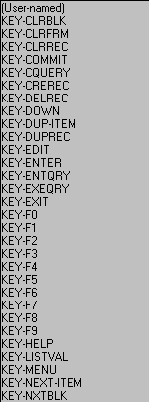
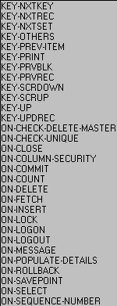
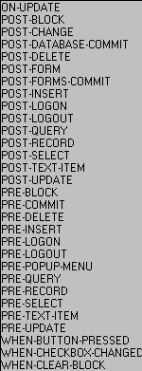
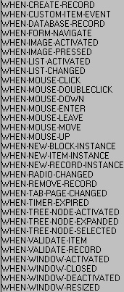
Trigger Type
Forms Builder Trigger Types
Notes:
Trigger Type (continued)
The first part of a trigger name (before the first hyphen) follows a standard convention; this helps you to understand the general nature of the trigger type, and plan the types to use.
Instructor Note
When-Mouse-Move/Enter/Leave triggers, although still in existence, are ignored when running on the Web due to the amount of network traffic that would be generated.

Slide 8
Trigger Code
Type
Scope
Code
  Statements
  PL/SQL
  User subprograms
  Built-in subprograms
Notes:
Trigger Code
The code of the trigger defines the actions for the trigger to perform when it fires. Write this code as an anonymous PL/SQL block by using the PL/SQL Editor. You need to enter the BEGIN. . . END structure in your trigger text only if you start your block with a DECLARE statement or if you need to code subblocks.
Statements that you write in a trigger can be constructed as follows:
Standard PL/SQL constructs (assignments, control statements, and so on)
SQL statements that are legal in a PL/SQL block; these are passed to the server
Calls to user-named subprograms (procedures and functions) in the form, a library, or the database
Calls to built-in subprograms and package subprograms
Although you can include SQL statements in a trigger, keep in mind the following rules:
INSERT, UPDATE, and DELETE statements can be placed in transactional triggers. These triggers fire during the commit process.
Transaction control statements (COMMIT, ROLLBACK, SAVEPOINT) should not be included directly as SQL trigger statements. These actions are carried out automatically by Forms as a result of either commands or built-in procedures that you issue. If included in triggers, these commands are redirected to be handled by Forms. For example, COMMIT will issue a COMMIT_FORM.

Slide 9
Trigger Scope
Type
Scope
Levels
  Form
  Block
  Item
Code
Notes:
Trigger Scope
The scope of a trigger is determined by its position in the form object hierarchy, that is, the type of object under which you create the trigger. There are three possible levels:
Form level: The trigger belongs to the form and can fire due to events across the entire form.
Block level: The trigger belongs to a block and can fire only when this block is the current block.
Item level: The trigger belongs to an individual item and can fire only when this item is the current item.
Some triggers cannot be defined below a certain level. For example, Post-Query triggers cannot be defined at item level, because they fire due to a global or restricted query on a block.
By default, only the trigger that is most specific to the current location of the cursor fires.

Slide 10
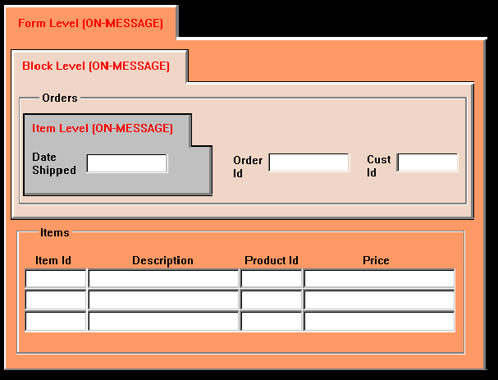
Trigger Scope
Order
Date
Event
Event
Event
Notes:
Trigger Scope (continued)
Consider the example in the diagram above:
When the cursor is in the Order_Date item, a message fires the On-Message trigger of the Order_Date item, because this is more specific than the other triggers of this type.
When the cursor is elsewhere in the ORDERS block, a message causes the
block-level On-Message trigger to fire, because its scope is more specific than the form-level trigger. (You are outside the scope of the item-level trigger.)
When the cursor is in the ITEMS block, a message causes the form-level
On-Message trigger to fire, because the cursor is outside the scope of the other two On-Message triggers.
Note: The On-Message trigger fires whenever Forms displays a message. It is recommended that you code On-Message triggers only at the form level.

Slide 11
Execution Hierarchy
Form
level
On-Message
On-Error
1
EH = Before
Block
level
On-Message
On-Error
2
4
Event
EH = After
EH = Override
Item
level
On-Message
3
Event
EH = After
Notes:
Execution Hierarchy
As already stated, when there is more than one trigger of the same type, Forms normally fires the trigger most specific to the cursor location. You can alter the firing sequence of a trigger by setting the execution hierarchy (EH) trigger property.
The diagram above shows how setting EH affects the firing order of triggers:
1. Fires first
2. Fires second
3. Fires third
4. Fires independently
Note: Broken lines indicate the analysis path before firing. EH stands for execution hierarchy.

Slide 12
Notes:
Execution Hierarchy (continued)
Execution hierarchy (EH) is a trigger property that specifies how the current trigger code should execute if there is a trigger with the same name defined at a higher level in the object hierarchy. Setting EH for form level triggers has no effect, since there is no higher level trigger.
Settings for execution hierarchy are:
Override: Only the trigger most specific to the cursor location fires. This is the default.
After: The trigger fires after firing the same trigger, if any, at the next highest level.
Before: The trigger fires before firing the same trigger, if any, at the next highest level.
In the cases of Before and After, you can fire more than one trigger of the same type due to a single event. However, you must define each trigger at a different level.
Instructor Note
Demonstration
Open the form EH_DEMO.fmb, which is based on the CUSTOMERS table. Point out that there are On-Error triggers defined at form level, block level, and item level (for CUSTOMERS.customer_id). The triggers just display a message indicating the level of the trigger that fires. Run the form and insert text into CUSTOMERS.customer_id, then navigate to the next item. This causes the On-Error trigger to fire only for the item level.
Set EH property to “before” for block level and to “after” for item level. Run the form and cause the error as before. This causes the On-Error triggers to fire according to the EH settings: first block level, then form level, and finally item level.
Point out to students that setting EH at form level would not affect the execution order. Also inform them that it is recommended to define On-Error triggers only at form level, but it is used here just to illustrate trigger scope.

Slide 13
Summary
In this lesson, you should have learned that:
  Triggers are event-activated program units
  You can categorize triggers based on function or name to help you understand how they work
  Trigger components are:
    Type: Defines the event that fires the trigger
    Code: The actions a trigger performs
    Scope: Specifies the level (form, block, or item) at which the trigger is defined
  The Execution Hierarchy trigger property alters the firing sequence of a trigger
Notes:
Summary
In this lesson, you should have learned the essential rules and properties for triggers.
Triggers are event-activated program units.
You can categorize triggers based on:
Function: Block-processing, Interface event, Master-detail, Message-handling, Navigational, Query-time, Transactional, Validation
Name: When-, On-, Pre-, Post-, Key-
Trigger components include:
The trigger type that defines the event that fires the trigger
The trigger code that consists of a PL/SQL anonymous bloc
The trigger scope that determines which events will be detected by the trigger; the three possible levels for a trigger are form, block, and item
When an event occurs, the most specific trigger overrides the triggers at a more general level. This can be affected by the Execution Hierarchy trigger property.
Instructor Note
Ask questions to test understanding of the lesson.

